Slide 1


Slide 2
Predicting Traffic Violation Penalty
By Lavanya Krishna and Dylan Tallis
PD: 5

Slide 3

01
Goal & Data

Slide 4
Project Goal
Model can aid in training police officers
Identify factors contributing to more severe penalties
Reduce human bias using objective rather than subjective characteristics
Time and location
Age and race

Slide 5
Description of Data
Traffic violations in Montgomery County, Maryland
2014 - present, updated daily
43 attributes
299,777 missing values
Instances
All Data
1.96 million
2024 Data
58,679

Slide 6
Description of Data
Class: "Search Outcome"
Warning
Citation
Safety Equipment Repair Orders (SERO)
Arrest

Slide 7
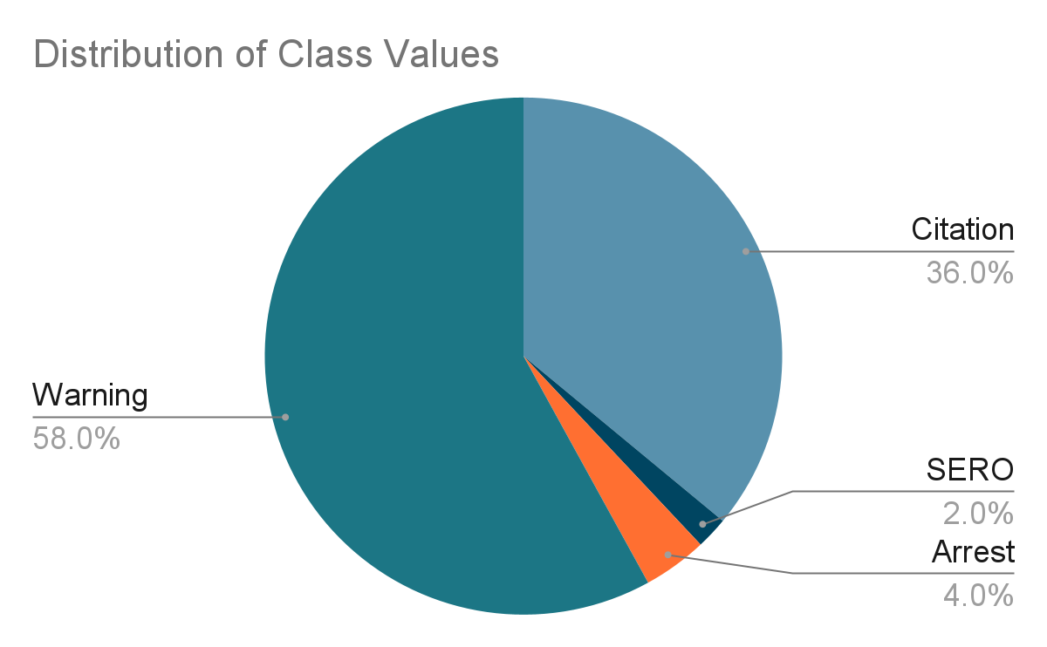

Slide 8
02
Tools & Preprocessing

Slide 9
Tools Used
Montgomery Data: 2024 data
Visual Studio Code: Preprocessing.
Google Colab: Stratified samples and splitting datasets
Notepad: Change attribute data types
Weka: Attribute selection and classifier model testing
Google Sheets: Graphing results

Slide 10
Initial Data Cleaning
Removed:
Apostrophes, double quotes, and return characters
4 attributes with over 97% missing values
Search Disposition, Reason, Type, and Arrest Reason
Instances with missing class value
40% of dataset
35,208 instances

Slide 11
Random Sampling
Stratified Random Sampling: 1000 instances
Removed:
Commercial Vehicle, Agency, Fatal, HAZMAT, Alcohol, and Work Zone: one value
Article: bias
Geolocation: derivable
Violation Type: same as class
SeqID: index

Slide 12
Cleaning and Splits
Change attribute type from string to nominal
Change attribute type to date
Save as .arff
Training, Validation, and Testing
train_test_split
Did not use

Slide 13
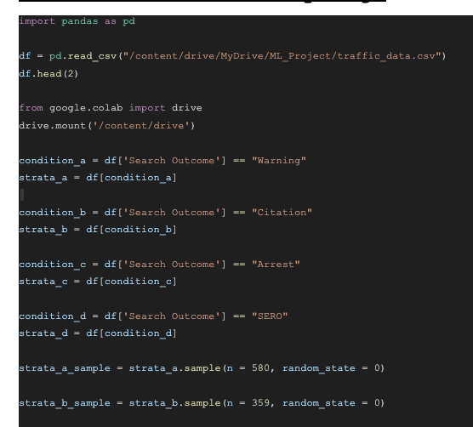
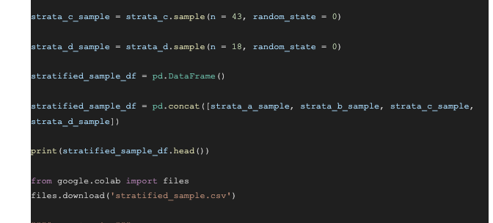
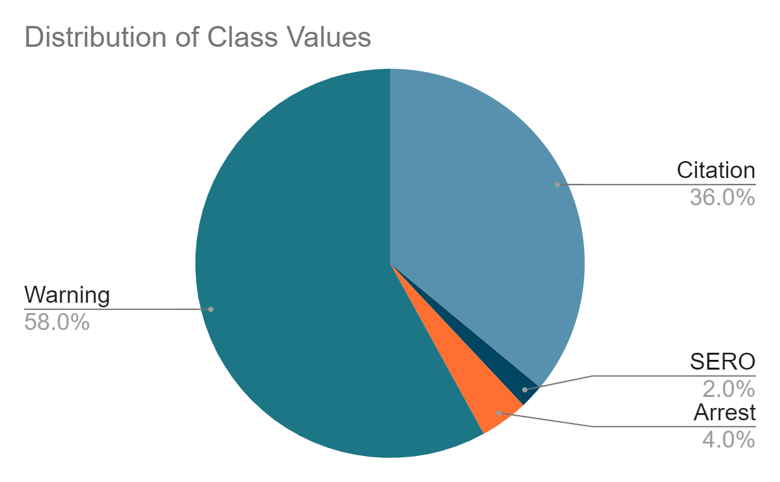

Slide 14
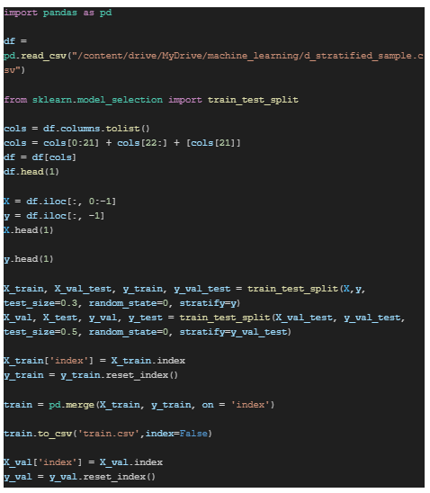
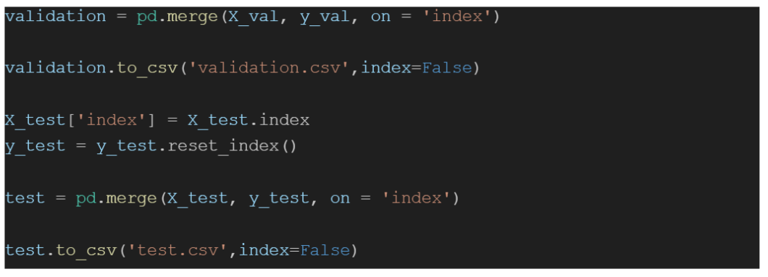

Slide 15
03
Attribute Selection

Slide 16
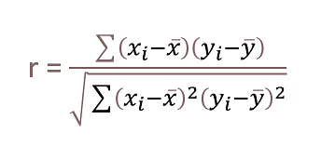
CorrelationAttributeEval
Pearson’s correlation between attribute and class
Cutoff value: 0.1
Selected attributes:
Search Conducted
Accident
Contributed To Accident
Property Damage
Gender

Slide 17
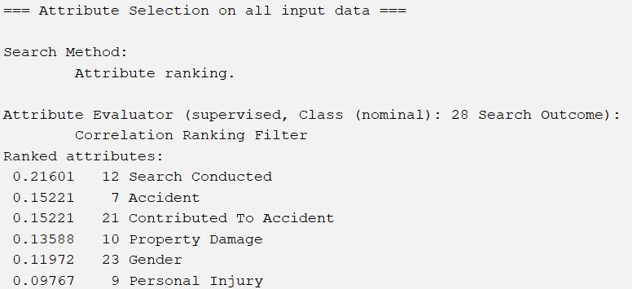

Slide 18
CfsSubsetEval
Individual predictive ability and redundancy
Selected attributes:
Location
Personal Injury
Property Damage
Search Conducted

Slide 19
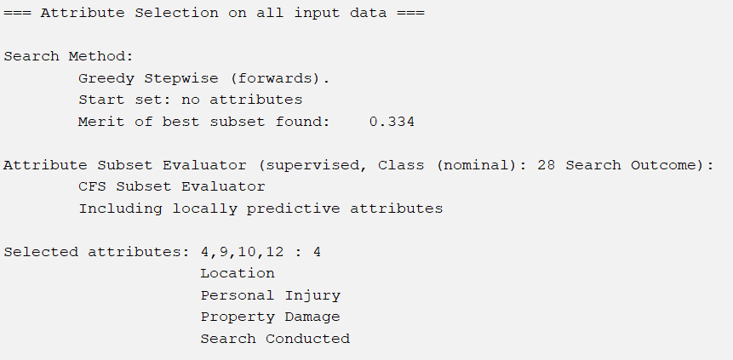

Slide 20
InfoGainAttributeEval
Information gain with respect to class, entropy
Cutoff value: 0.2
Selected attributes:
Location
Model
Charge
Search Reason For Stop
Search Conducted
Driver City

Slide 21
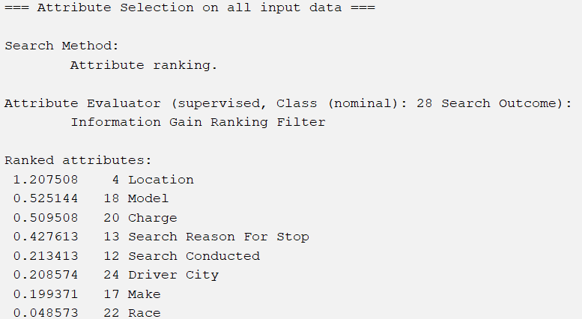

Slide 22
GainRatioAttributeEval
Gain ratio in relation to class
Cutoff value: 0.1
Selected attributes:
Search Conducted
Personal Injury
Property Damage
Accident
Contributed To Accident
Location

Slide 23
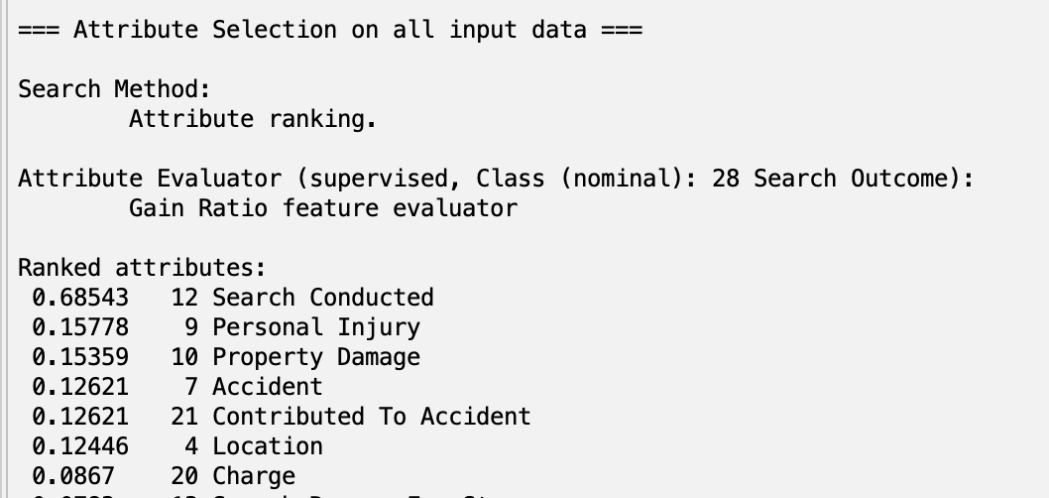

Slide 24
OneRAttributeEval
Set of rules for one attribute with lowest error rate
Cutoff value: 60
Selected attributes:
Charge
Search Reason For Stop
Search Conducted
Race

Slide 25
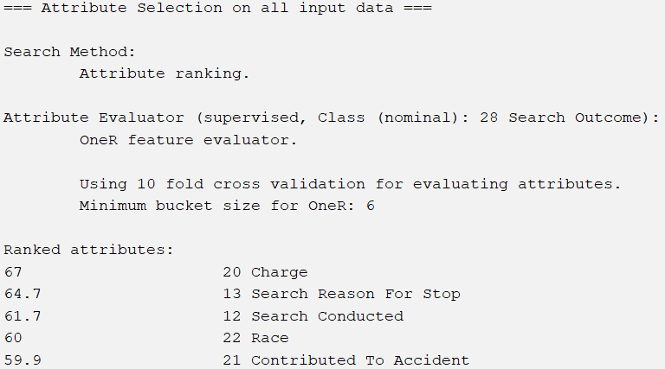

Slide 26
04
Classifier Models

Slide 27
Classifier Models
Naive Bayesian
OneR Classifier
Based on Bayes’ Theorem
Assumes features are independent
Predicts the class with the highest probability
Simple yet effective for supervised learning
Accessed via:
bayes → NaiveBayes
Creates simple rules based on a single feature
Selects the feature with the lowest error rate to form a rule
High accuracy in some cases despite simplicity
Accessed via:
rules → OneR

Slide 28
Classifier Models
J48 Classifier
Random Forest Classifier
Builds a decision tree by splitting data based on best attribute
Minimizes classification error
Decision tree used to predict the class of new instances
Balances simplicity and accuracy
Accessed via:
trees → J48
Builds a forest of random trees, each making independent predictions
Final prediction is based on majority voting across all trees
Trees are equally weighted
Accessed via:
tree → RandomForest

Slide 29
05
Results

Slide 30
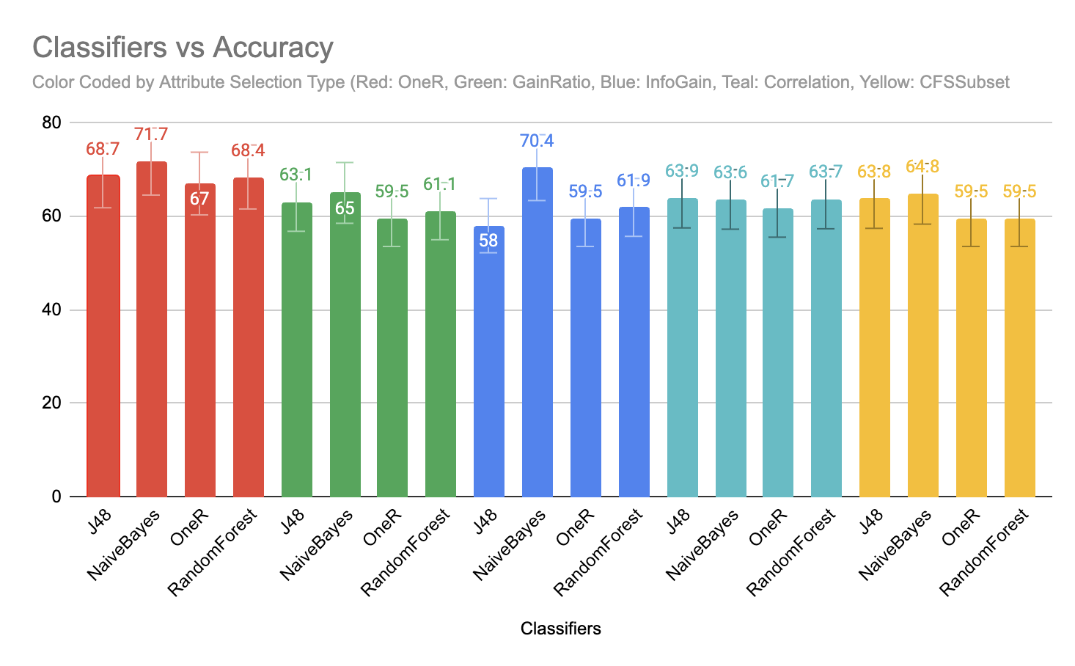
Legend:
OneR
GainRatio
InfoGain
Correlation
CFSSubset

Slide 31
Results
Highest Accuracy: OneR with Naive Bayes at 71.1%
Second Highest: Info Gain with Naive Bayes at 70.4%
Low error rates
Mean absolute, root mean squared, relative absolute, root relative squared
High precision and F-measure
High accuracy and low error are indicators of consistent performance

Slide 32
06
Conclusions

Slide 33
Common Attributes
Naive Bayes OneR and Info Gain shared attributes:
Charge
Search Reason For Stop
Search Conducted
Charge is the numeric code for the specific charge

Slide 34
Class Imbalance
Many models classified the majority as "Warning"
Confusion matrices show zeros in all columns except for "Warning"
Many True Positives and False Positives
Class imbalance: 58% of instances classified as "Warning"
Models perform well on majority class but poorly on minority classes

Slide 35
Class Imbalance - Improvements
Oversample minority classes
Undersample majority class
Assign class weights to emphasize minority class misclassification

Slide 36
Human Bias
Each violation penalty is given in a unique situation
Variations in penalty due to officer’s…
Emotions
Fatigue
Level of experience
Personal bias towards driver

Slide 37
Human Bias - Improvements
Create a dataset with a minimum level of experience
Only consider traffic violation data that was reported by officers who have achieved that level

Slide 38
Thank you! Questions?

